Slide 1

PaperMind AI
Presented by: Aritra Dey
College: MCKV Institute of Engineering
Department: CSE / Data-Science
AICTE Student Registration Id: STU69cd69923b5331775069586
PaperMind AI | GenAI Research Paper Assistant | 1

Slide 2
Outline
Project presentation structure
Problem Statement
Proposed System / Solution
System Development Approach
Algorithm & Deployment
Result
Conclusion
Future Scope
References
GitHub & Deployment Link
PaperMind AI | GenAI Research Paper Assistant | 2

Slide 3
Problem Statement
The challenge faced by students and researchers
Key Problems
• Research papers are lengthy, technical, and difficult to understand quickly.
• Students spend significant time extracting key contributions, methodology, results, and limitations.
• General chatbots can hallucinate because they are not grounded in the uploaded paper.
• Users also need learning support such as quizzes, comparison, and presentation generation For Better Understanding.
PaperMind AI | GenAI Research Paper Assistant | 3

Slide 4
Proposed System / Solution
A RAG-based research assistant for paper understanding
WorkFlow
Upload PDF
Extract Text
Chunking
Embeddings
FAISS
LLM Answer
Solution Overview
• The system accepts research paper PDFs and converts them into searchable chunks.
• FAISS retrieves relevant paper sections for each user query.
• Gemini, Groq, and Ollama are used in a hybrid fallback pipeline for reliable answer generation.
• Additional modules generate summaries, insights, quizzes, PPTs, comparisons, and paper recommendations.
PaperMind AI | GenAI Research Paper Assistant | 4

Slide 5
System Development Approach
Technologies and modules used
Frontend & Interaction Layer
Processing Layer
AI, Retrieval & Generation Layer
• PyPDF-based research paper text extraction
• Text cleaning to remove extra spaces and noisy formatting
• Fixed-size chunking for long document handling
• Sentence Transformer embeddings for semantic representation
• FAISS index creation for fast vector similarity search
• RAG pipeline retrieves top-k relevant chunks for user queries
• Gemini/Groq/Ollama used for LLM-based response generation
• Hybrid fallback improves reliability during quota or API failures
• Prompt engineering used for summaries, quizzes, PPT JSON, and comparison
• arXiv API integration enables topic-based paper discovery
• Streamlit-based web interface for real-time interaction
• Multi-tab workflow: Insights, Quiz, PPT, Compare, Q&A, Paper Finder
• Custom CSS for responsive dashboard-style UI
• PDF upload, result display, and file download support
PaperMind AI | GenAI Research Paper Assistant | 5

Slide 6
Algorithm & Deployment
End-to-end execution workflow
Algorithm
Deployment Approach
• Step 1: User uploads one or more research paper PDFs.
• Step 2: Text is extracted, cleaned, and split into chunks.
• Step 3: Chunk embeddings are generated using Sentence Transformers.
• Step 4: FAISS stores vectors and retrieves top relevant chunks.
• Step 5: Hybrid LLM pipeline generates answers and outputs.
• Step 6: Streamlit displays insights, quiz, PPT, comparison, and Q&A.
Local command: streamlit run app.py
Environment variables stored in .env
Gemini used when available
Groq used as cloud fallback
Ollama used as local fallback
Can be deployed on Streamlit Cloud after securing keys
PaperMind AI | GenAI Research Paper Assistant | 6

Slide 7
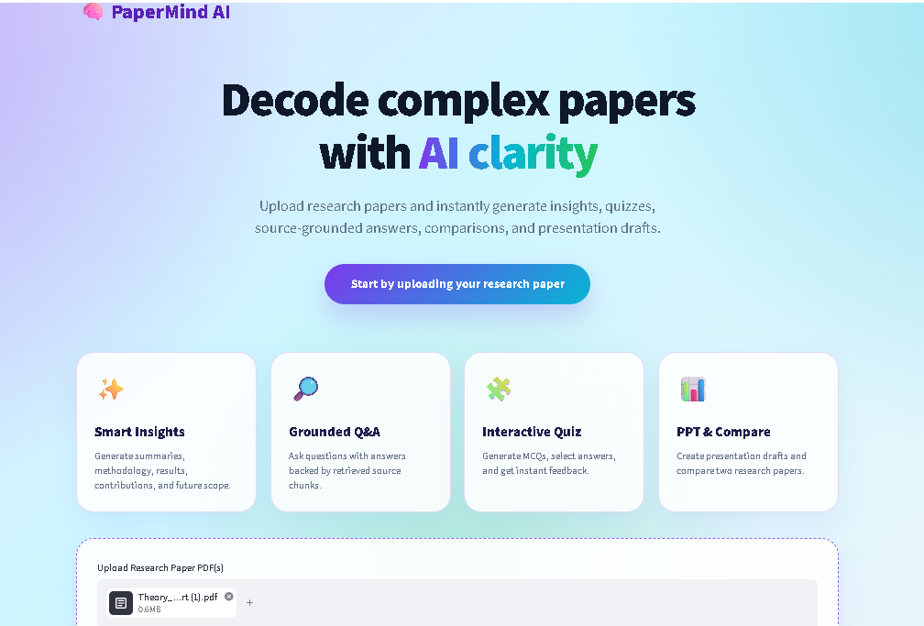
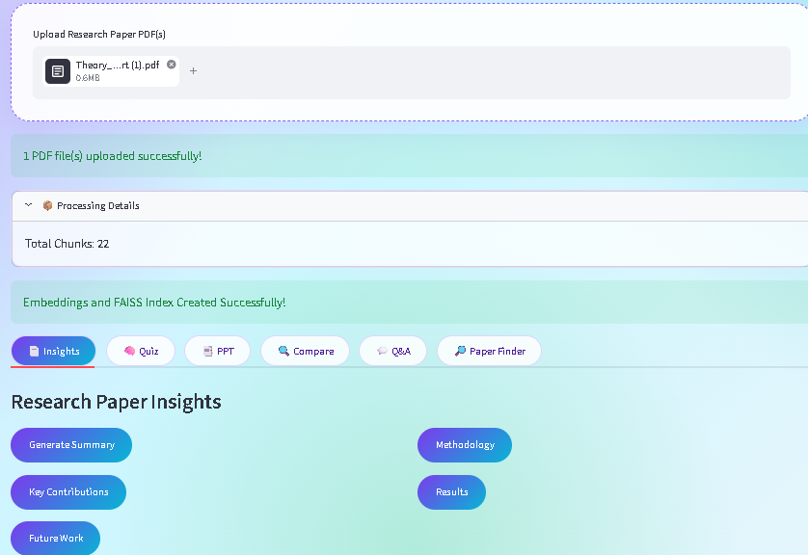
Result
Implemented features and outcomes
Project Output
Successfully uploads and processes research paper PDFs.
Generates structured summaries, key contributions, methodology, results, and future scope.
Provides RAG-based Q&A with source chunks for transparency.
Creates interactive MCQ quizzes with answer checking and score display.
Generates PowerPoint drafts and compares two research papers.
Finds related research papers using arXiv search.
PaperMind AI | GenAI Research Paper Assistant | 7

Slide 8
Conclusion
Summary of project achievement
PaperMind AI converts complex research papers into understandable and usable knowledge.
The RAG pipeline improves answer reliability by grounding responses in uploaded paper chunks.
Hybrid LLM fallback makes the system more robust against API quota or connectivity issues.
The application supports learning and productivity through summaries, quizzes, PPT generation, and comparison.
Makes complex research papers easier for students to understand.
Saves time in reading, summarizing, and preparing presentations.
It makes academic knowledge more accessible, supports inclusive learning, and encourages students to engage with research and innovation.
PaperMind AI | GenAI Research Paper Assistant | 8

Slide 9
Future Scope
Possible improvements and extensions
Future Enhancements
• Add page-number citations and section-level references.
• Improve PDF extraction using PyMuPDF for tables, figures, and equations.
• Add permanent chat history and user authentication.
• Improve PPT generation with advanced templates, charts, and visual extraction.
• Deploy on cloud with secure API key management.
• Support more academic databases such as Semantic Scholar and CrossRef.
PaperMind AI | GenAI Research Paper Assistant | 9

Slide 10
References
Tools, libraries and platforms used
Reference Platforms
Streamlit – Python framework for web applications https://streamlit.io/
FAISS – Vector similarity search library https://faiss.ai/
Sentence Transformers – Embedding generation https://sbert.net/
Google Gemini API – LLM generation https://ai.google.dev/gemini-api/docs
Groq API – Fast LLM inference https://console.groq.com/docs/overview
Ollama – Local LLM execution https://ollama.com/
arXiv API – Research paper discovery https://info.arxiv.org/help/api/user-manual.html
python-pptx – PowerPoint generation https://python-pptx.readthedocs.io/
PaperMind AI | GenAI Research Paper Assistant | 10

Slide 11
GitHub & Deployment Link
Project sharing details
Project Links
• GitHub Link : https://github.com/Aritra-Dey2004/PaperMind-AI
PaperMind AI | GenAI Research Paper Assistant | 11

Slide 12
THANK YOU
PaperMind AI | GenAI Research Paper Assistant | 12

